Slide 1


Python for DevOps
Presenter
Mohammad Anees Alam
Notes:
1

Slide 2
Topics for today!
1
Why Python?
2
Python based tools
3
Fundamental concepts
4
Control Structures
5
Functions & Modules
6
Hands-on Activity
Mohammad Anees Alam
Notes:
2

Slide 3
Why Python is a Popular Choice in DevOps?
Automation
1
Python is good for automating repetitive tasks like updating servers or checking server health. For example, you can write a Python script to pull the latest code from GitHub and deploy it automatically to a server.
2
CI/CD Pipelines
Python helps automate processes like testing and deploying code, which speeds up software development. You can use Python to trigger actions in tools like Jenkins when new code is ready to be deployed.
Infrastructure Management
3
Python helps manage servers and cloud services automatically, reducing errors. Tools like Ansible and Terraform are powered by Python to help configure servers or set up cloud resources.
4
Cloud Interaction
Python is great for working with cloud platforms like AWS. For instance, using Python, you can manage cloud resources like virtual machines or storage with tools like Boto3.
Mohammad Anees Alam
Notes:
3

Slide 4
Python-based DevOps Tools
Ansible
AWS Boto3
Terraform
Automates tasks like installing software or configuring multiple servers, powered by Python.
Python’s tool for automating actions in Amazon Web Services (AWS), like managing virtual machines or storage.
Though not written in Python, Python is often used to automate related tasks like running deployment scripts or managing configurations.
Mohammad Anees Alam
Notes:
4

Slide 5



Scenarios Where Python Simplifies Tasks
Python scripts can be used to automate application deployment, reducing manual errors and speeding up deployment times. This is especially helpful in a CI/CD pipeline to ensure quick and error-free updates.
Python enables automation of infrastructure provisioning, which saves time and ensures consistency in the setup. For example, Python can interact with cloud providers to automatically launch, configure, and manage virtual machines, storage, and networking.
Python is commonly used to create monitoring scripts that check server health, disk space, or application uptime. It can also be used to send alerts or notifications when an issue arises.
Mohammad Anees Alam
Notes:
5

Slide 6
Points to remember!
Syntax:
  We don't need to explicitly define the data type of the variable, python automatically figures out the type based on the value you assign to it.
  Save the python code with .py format. (automations.py)
Indentation:
  Indentation is crucial in Python!
  Unlike many other programming languages that use braces or other delimiters to define blocks of code, Python uses indentation to determine the structure of the program.
Naming Variables:
  Use descriptive names for variables (e.g., age, total_price).
  Follow the snake_case format (lowercase words separated by underscores).
  Don't use reserved words (like if, for, def, class) as variable names.
Function Definitions
  Always define functions with def and give them a meaningful name.
  Use parentheses () for parameters and a colon : to start the body
Mohammad Anees Alam
Notes:
6

Slide 7
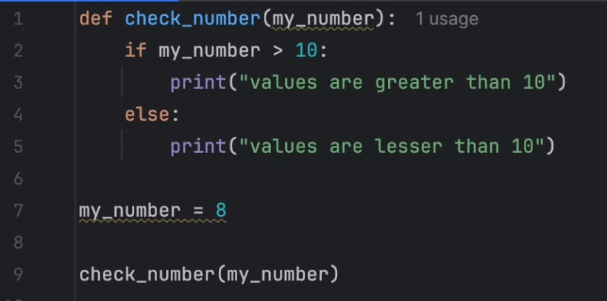
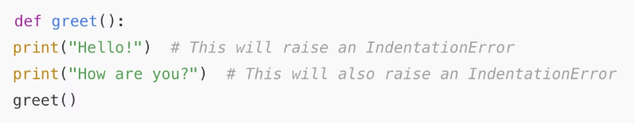
Sample python code
The below lines of code shows us how to use indentation, how to define functions, how to use descriptive naming and avoid using reserved words from python library.
Mohammad Anees Alam
Notes:
7

Slide 8
Python: Data Types & Collections
These data types and collections are essential for working with different kinds of information in Python.
  Data types are the different kinds of values that can be stored in a variable.
  Collections allow you to store multiple values in a single variable. These are more complex data types that group together several values.
Data types
Collections
int (Integer): Whole numbers, +ve or -ve without a decimal point.
list: A collection of items that can be changed (mutable). Lists can hold different types of data.
  Example: age = 30
  fruits = ["apple", "banana", "cherry"]
float (Floating-point number): Numbers with a decimal point.
tuple: A collection of items, but tuples are immutable (unchangeable after creation).
  Example: price = 19.99
  colors = ("red", "green", "blue")
str (String): A sequence of characters, used for text.
  Example: name = "Alice"
set: A collection of unique items, it doesn’t allow duplicate values.
  numbers = {1, 2, 3, 4}
bool (Boolean): A type that can be either True or False.
dict (Dictionary): A collection of key-value pairs, where each key is unique.
  Example: is_active = True
  person = {"name": "John", "age": 25}
Mohammad Anees Alam
Notes:
8

Slide 9
Operators and their types:
  Operators are symbols or keywords used to perform operations on variables and values in a programming language.
  They allow you to perform calculations, comparisons, and logical operations, act as tools that help in processing data or making decisions within your code.
Logical Operators
Arithematic Operators
Often used in conditional statements, like checking if multiple conditions are met before proceeding with tasks (e.g., a deployment).
Useful for handling numerical tasks like monitoring metrics.
1
2
3
4
Comparison Operators
Asssignment Operators
Used to check conditions such as whether a server is up or whether a system is within acceptable performance limits.
Frequently used to update values in configuration files, scripts, or manage resource allocations.
Mohammad Anees Alam
Notes:
9

Slide 10
Arithmetic & Logical Operators:
Arithmetic Operators: Essential in DevOps when you’re automating tasks that involve calculations, such as resource allocation, load balancing, or disk space management.
Logical Operators: In a DevOps pipeline, you might want to check if two conditions are true before deploying a new update.
Common Arithmetic Operators:
Common Logical Operators:
  + (Addition): Adds two values.
  and: Returns True if both conditions are true.
  - (Subtraction): Subtracts one value from another.
  or: Returns True if at least one condition is true.
  * (Multiplication): Multiplies two values.
  not: Reverses the logical state of the condition.
  / (Division): Divides one value by another.
  // (Floor Division): Divides and returns the largest integer smaller than the result.
  % (Modulo): Returns the remainder of the division.
  ** (Exponentiation): Raises a number to the power of another number.
Mohammad Anees Alam
Notes:
10

Slide 11
Comparison & Assignment Operators:
Comparison Operators: Particularly useful in DevOps automation to check whether certain conditions are met (e.g., if a server is online, if a resource usage is within limits, etc.).
Assignment Operators: Commonly used in DevOps automation to update configuration settings, track resource usage, or assign values during script execution.
Common Comparison Operators:
Common Assignment Operators:
  == (Equal to): Checks if two values are equal.
  =: Assigns a value to a variable.
  != (Not equal to): Checks if two values are not equal.
  +=: Adds and assigns the result to the variable (equivalent to x = x + y).
  > (Greater than): Checks if the left value is greater than the right.
  -=: Subtracts and assigns the result to the var (equivalent to x = x - y).
  < (Less than): Checks if the left value is less than the right.
  *=: Multiplies and assigns the result to the var (equivalent to x = x * y).
  >= (Greater than or equal to): Checks if the left value is greater than or equal to the right.
  /=: Divides and assigns the result to the variable (equivalent to x = x / y).
  //=: Floor divides and assigns the result (equivalent to x = x // y).
  <= (Less than or equal to): Checks if the left value is less than or equal to the right.
  %=: Assigns the remainder of the division (equivalent to x = x % y).
  **=: Raises the variable to the power of the right-hand value and assigns it.
Mohammad Anees Alam
Notes:
11

Slide 12
Control Structures: Conditions and Loops
  Control structures in Python are used to control the flow of execution of a program based on certain conditions or loops.
  They are fundamental to writing logic and handling different cases in the program.
Conditions
Loops
  if: Runs the code block if the condition is true.
  For Loop: Iterates over a collection of range (list, tuple, etc.).
  if-else: Runs one block of code if the condition is true and another if false.
  While Loop: Repeats a block of code, as long as a condition is "True".
  if-elif-else: Checks multiple conditions and runs the corresponding code block for the first true condition.
  Break, continue & pass are used to alter the flow of a loop.
Note:
  break: Exits the loop completely.
  continue: Skips the current iteration and moves to the next iteration.
  pass: A placeholder for code that does nothing (useful in situations where code is syntactically required but you don’t want to implement it yet).
Mohammad Anees Alam
Notes:
12

Slide 13
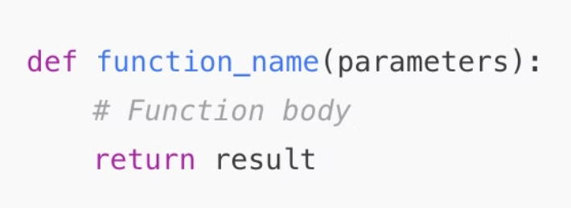
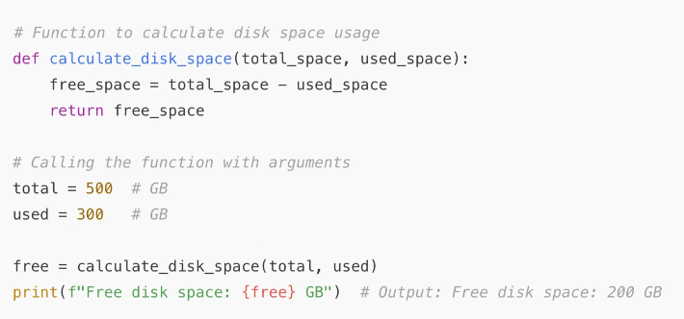
Functions
  Functions allow you to group code into reusable blocks.
  They can take inputs, perform operations, and return results.
Syntax:
  def is the keyword to define a function.
Passing Arguments and Returning Values:
  function_name is the name of the function (should be descriptive).
  total_space and used_space are arguments passed into the function.
  parameters are values that can be passed to the function (optional).
  The function calculates and returns the free disk space (free_space).
  return sends a result or value back to the calling code.
  The returned value is stored in the free variable, which we then print.
Mohammad Anees Alam
Notes:
13

Slide 14
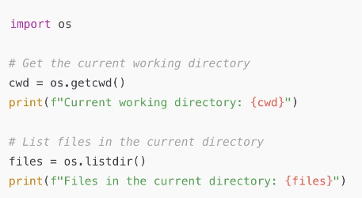
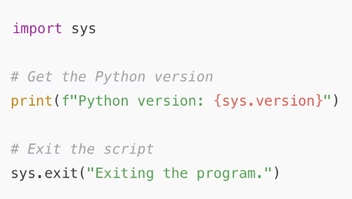
Modules
  Modules are pre-build blocks of code that can be reusable without having to write them yourself.
  These modules contain reusable functions, variables or classes to handle common tasks like managing files, interacting with OS or manage networking aspects.
Commonly used modules are: os module & sys module.
  The os module provides a way to interact with the operating system to perform system-level operations like file management, working with environment variables and more.
  The sys module is useful for interacting with the command line, handling arguments, and managing the Python runtime environment (software that runs python code).
OS_Module:
SYS_Module:
Common functions in the os module:
Common functions in the sys module:
  os.name: Returns the name of the OS dependent module imported.
  sys.argv: A list of command-line arguments passed to the script.
  os.getcwd(): Returns the current working directory.
  sys.exit(): Exits the program.
  os.listdir(): Returns a list of files and directories in the specified path.
  sys.version: Returns the Python version being used.
  os.system(command): Executes a system command (like a shell command).
Note:
  We can also create our own modules > save it with .py > use it by importing in our code.
Mohammad Anees Alam
Notes:
14

Slide 15
Using Modules in Python
You can import a module using the import keyword and then use its functions and classes in your script.
There are several ways to import a module:
Import the whole module:
import os
print(os.getcwd())
Import specific functions from a module:
from os import getcwd
print(getcwd())
Alias the module for easier reference:
import os as operating_system
print(operating_system.getcwd())
Mohammad Anees Alam
Notes:
15

Slide 16
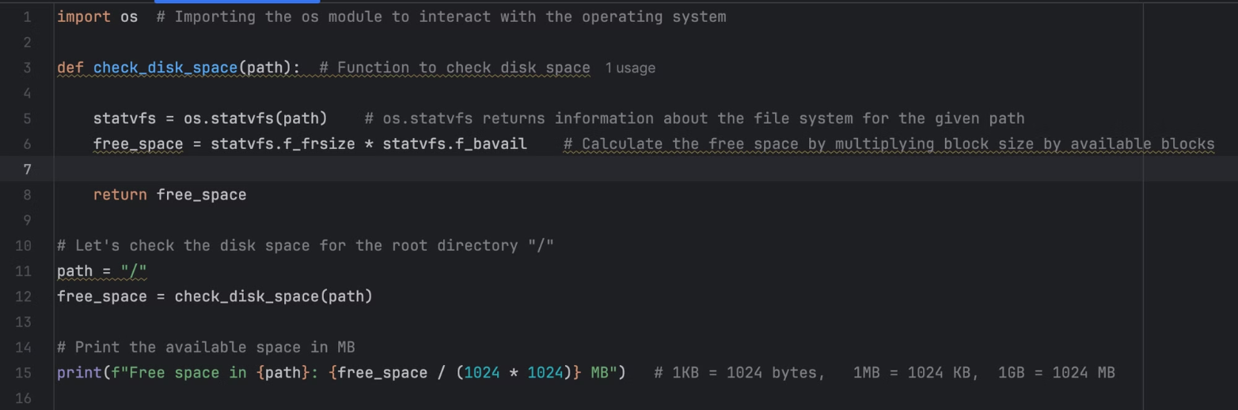
Hands-on Activity!
  A python script that checks "how much disk space is available on your system".
  Since the disk space is related to operating system (OS), we will import the built-in os_module for this script.
  Lines that contain statvfs are just functions from os module, need not memorize these as we have numerous logic blocks inside each module.
Mohammad Anees Alam
Notes:
16

Slide 17





What have we learnt today!
Why Python for DevOps: Python simplifies automation, infrastructure management, and CI/CD pipelines, integrating with cloud platforms like AWS and tools such as Ansible and Terraform.
Introduction to Python: Deep dived into Syntax formats like indentation, naming variables, data types & collections, Operators and their use cases which are arithmetic, logical, assignment and comparison.
Control Structures: Conditional statements (if-else) and loops (for, while) allow dynamic control over program flow, enabling effective handling of different scenarios.
Functions and Modules: Functions promote modular, reusable code, while Python modules like os and sys expand functionality, facilitating system and task automation.
Mohammad Anees Alam
Notes:
17

